Slide 1
Global Azure Bootcamp April 2017
San Francisco, CA
Wi-Fi Code: ???
Sample Code on USB sticks or
https://github.com/TexasJetter/AzureBootCamp2017

Slide 2

Welcome to the
San Francisco, CA

Slide 3









About the Presenter
Jeff Etter
Senior Software Developer EPS Software Corp.
North Houston .Net Users Group Board Member
CODE Magazine Author
jetter@eps-software.com
@TexasJetter

Slide 4


About the Presenter
Chris Camaclang
Solutions Engineer at Alert LogicManager
Chris has over 20 years of experience in data center infrastructure and public cloud environments. He began his IT career in the aerospace industry supporting operations in large enterprise datacenter networks and compute environments. At Alert Logic, Chris helps security professionals find solutions to meet their compliance needs for on-premises, hybrid, and dedicated public cloud environments.
ccamaclang@alertlogic.com

Slide 5
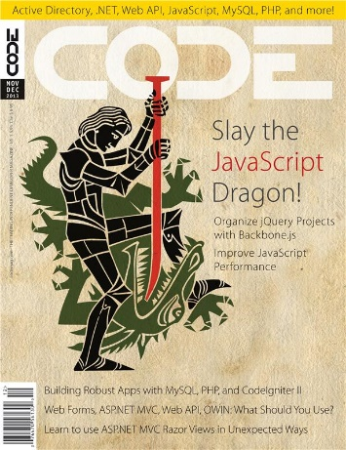
About CODE & EPS Software Corp.
“Helping People Build Better Software”
Custom Software, Consulting, Training, Mentoring,…
Cloud, Windows, Web, Mobile
Data
User Interface and Interaction Design
Project Rescue
Legacy Conversions

Slide 6






A BIG thank you to the 2017 Global Sponsors!
For providing the “Stuff We All Get”!

Slide 7



“Stuff We All Get”
Sponsor | Offering
Cloudmonix https://cloudmonix.com/ | Cloudmonix offers 1 full month of unlimited monitoring under the Ultimate plan.
SentryOne http://www.sentryone.com/ | SQL Sentry offers an extended evaluation for every attendee.
ServiceBus360 http://www.servicebus360.com/ | Servicebus360 offers an extended license until September 30 for all attendees, and this for 3 namespaces, 3 alarms per namespace, 3 resources per namespace to monitor and 2 users.
OpsGility http://www.Opsgility.com/ | Opsgility offers a 30 day subscription free trial for all attendees.

Slide 8

Raffle Prizes
1 Winner: One license chosen from ReSharper, dotTrace Memory, dotTrace Performance, dotCover, dotPeek, PhpStorm, PyCharm, IntelliJ IDEA, AppCode, WebStorm, RubyMine. You’ll receive a voucher with a code from the organizers.
1 Winner: a 1 year license of DBSentry (formerly Performance Advisor for Azure SQL Database) for raffle per location. Give your Full name and email to the Organizers.
MyGet is offering a free Starter subscription for 1 year for 1 attendee per location. Give your Full name and email to the Organizers.
They offer 3 12-month subscriptions per GAB Location.
Give your Full name, email phone and company to the Organizers.

Slide 9
Agenda
Cloud Security (Alert Logic)
Using the Cloud Effectively
GolfTracker Sample App
Person Sample App
Architecture
Set up Development Environments
Lab
Q & A

Slide 10
Using the Cloud Effectively
Infrastructure as a Service (IAAS)
Platform as a Service (PAAS)
Software as a Service (SAAS)
Notes:
IAAS is virtual machines, etc. more for IT
PAAS is the sweet spot for developers (Azure SQL, DocumentDB, App Services, Blob Storage, etc…)
Makes it easy to share with dev teams across the globe, quickly put up dev, demo, QA & production environments, give dev teams access to vast resources & scale as well as services like big data, Cortana, etc.
SAAS is like O365, MS Team Services, Facebook, etc. (Pre-build stuff for end users to use)

Slide 11
Racing Game
Real-time distributed game we can all download and play now (176MB + 7MB)
Source code available
http://gabracing.azurewebsites.net
San Francisco: CFU-TMO-YQS

Slide 12
Architecture of the Sample Apps
IBM
GolfTracker Service
GolfTracker Web App
Document DB
AWS
Person Web App
SQL Azure
Person Service

Slide 13
Web Applications In Azure
Demo
http://eps-azureboot2017-person-app.azurewebsites.net
http://golftrackerng.azurewebsites.net

Slide 14
Create a Database In Azure
Lab
https://github.com/TexasJetter/AzureBootCamp2017 (Person)

Slide 15
Service Layer
Services are endpoints (addresses) that provide logic and data to an application UI
Services are the ‘back end’ parts of a system
All modern applications use services, not just modern web applications
The concept of services is crucial to modern development

Slide 16
Micro-Services
Small
Lightweight
Independently developed and deployed
In the future, services will likely be deployed in containers

Slide 17
Setting Up Development Environment
Visual Studio 2017 Community Edition or higher
SQL Server Express (full install) 2016 or higher
Visual Studio Code http://http://code.visualstudio.com/
Node.js and NPM https://nodejs.org/en/download/
Angular CLI npm install -g @angular/cli
Postman (Windows or Chrome) https://www.getpostman.com/apps [optional]

Slide 18
In Terms of JSON over REST
HttpGet A List of People containing the string “yeag”
HttpGet The Person with Id “3632BFA5-F0BF-4AB1-B5A2-DB1708783A6C”
HttpPost Save This Person:
{
“Id”: “3632BFA5-F0BF-4AB1-B5A2-DB1708783A6C”,
“FirstName”: “Mike”,
“LastName”: “Yeager”,
“Email”: “myeager@eps-software.com”,
“Phone”: “(832) 717-4445”,
}

Slide 19
Programming Server Side - Services
All non-UI code should be in services
JSON over REST is the de-facto standard
WebAPI or Node.js or ASP.NET Core WebAPI
Assumed to be published on the same domain as the web site
Use web server’s authentication – same authentication as the web site
No cross-domain security issues

Slide 20
What Do Services Look Like?
GetPeopleMatching(“yeag”)
GetPerson(3632BFA5-F0BF-4AB1-B5A2-DB1708783A6C)
SavePerson(3632BFA5-F0BF-4AB1-B5A2-DB1708783A6C, “Mike”, “Yeager”, “myeager@eps-software.com”, “(832) 717-4445”, …)

Slide 21
How Do We Build Services?
WebAPI / IIS
WCF
WCF / CODE Framework / WebAPI / IIS
Node.js
PHP
Java
.NET http
.NET Core & ASP.NET Core
Etc…, etc…, etc…
Notes:
RESTful services using JSON over HTTP are king.

Slide 22
Creating Services in .NET Core
Lab
https://github.com/kahanu/AzureBootcamp2017 (Golf Tracker)

Slide 23
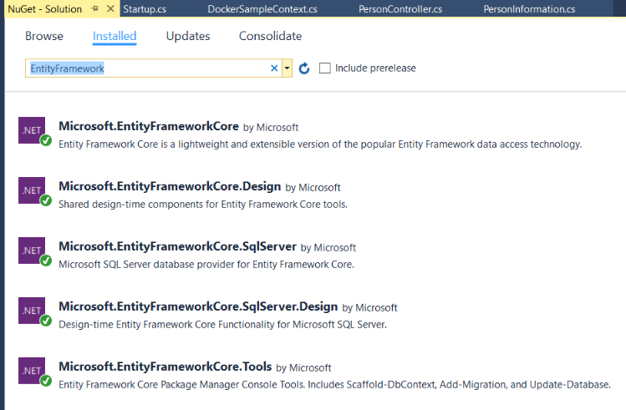
Creating Services in .NET Core

Slide 24
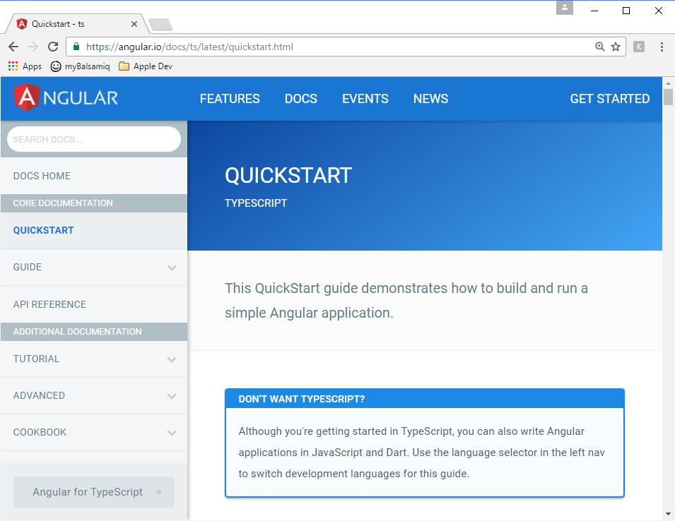
ASP.NET WebForms or MVC Architecture
Browser
IIS Server(s)
Controller (C#)
View (HTML)
Model (C#)
Database Server(s)
Database
Notes:
The web server did everything, including generate the web page.

Slide 25
SPA Architecture
Browser
Any Web Server(s)
Static Web Pages
ViewModel (.js)
Services (C# / Node)
DOM (.js & .html)
Database Server(s)
Database
Notes:
The web server now provides a few basic things like authentication.
Most of the web page is now generated in the browser.

Slide 26
Implications
Web server does a whole lot less:
Serves (mostly) static web pages
Authenticates users
Hosts service calls
Browser does a whole lot more
HTML is built or served from JavaScript
AJAX service calls / No post backs
UI flow
UI logic

Slide 27
What is Angular ?
Angular is a (massive) framework for building JavaScript applications including, but not limited to browser applications (SPAs)
Released (out of CTP) in September 2016
A re-thinking of version 1
Includes features such as data-binding, HTML templating, in-browser routing, application structure, out of the box support for CSS styling, and a whole lot more!
Built with TypeScript
Utilizes many other open source js ‘frameworks’

Slide 28
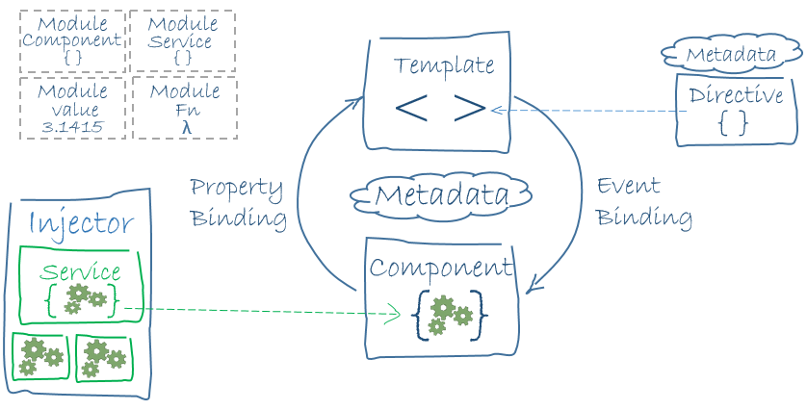
Angular Architecture
https://angular.io/docs/ts/latest/guide/architecture.html

Slide 29
In .NET We Would Call That…
Annotation/Decorator → Attribute (e.g. @Module, @Component, @Injectable)
Promise → Task (async & await)
@Module → Manifest for a Logical Grouping / SPA
@Component → Page or Part of a Page
.then() → Callback
Import → using in C#

Slide 30
Angular Concepts & Terms
Module (manifest for logical grouping)
Component (page or part of a page)
Template (html)
Metadata (attributes)
Data Binding
Directive (component, structural e.g. NgFor, attribute e.g. [(NgModel)] )
Service (class shared across many components)
Dependency Injection (default way to spin up new instances)

Slide 31
Angular Concepts & Terms cont’d…
Selector (find this html tag an insert the template there)
Router Outlet (client side routing: show routed pages in this html tag)
Imports (use other modules in this module)
Exports (make available to other modules)
Declarations (declare components that are part of a module)
Providers (create instances for dependency injection)

Slide 32
Imports (using in C#)
FRAMEWORK:
import { Http, Headers } from '@angular/http';
CLASSES:
import { Person } from '../classes/person';
JAVASCRIPT:
import 'rxjs/add/operator/toPromise';

Slide 33
Data Binding
{{ }} interpolation –> 1 way
( ) event binding <– 1 way
[ ] property binding –> 1 way
[( )] 2 way <–>
<#mike class=“MyClass”…> (template reference)
{{ mike.className }}

Slide 34
Creating Angular UI
Lab

